Slide 1
Data Visualizations to Show Data Distributions
Module: 4 – Data Distributions – The Theory
DVP
CS6

Slide 2
Data Visualizations – Data Distributions
Why visualize data distributions?
What big-picture questions can be answered using data visualizations that show data distributions?

Slide 3
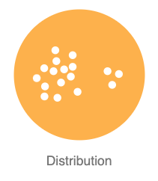
Why visualize data distributions?
It is the most basic way of providing a summary of a set of data.
When done correctly, visualizations of data distributions can provide a statistical summary of a set of data. (mean, median, mode, quartiles, etc.)
When done correctly, can quickly identify outliers (possible points of concern or opportunity needing investigation)
And all the above for quickly comparing different sets of data (i.e., different variables)!
As always, allows for quick insights for decision making and action!
Notes:
Image source:
https://datavizcatalogue.com/search/distribution.html

Slide 4
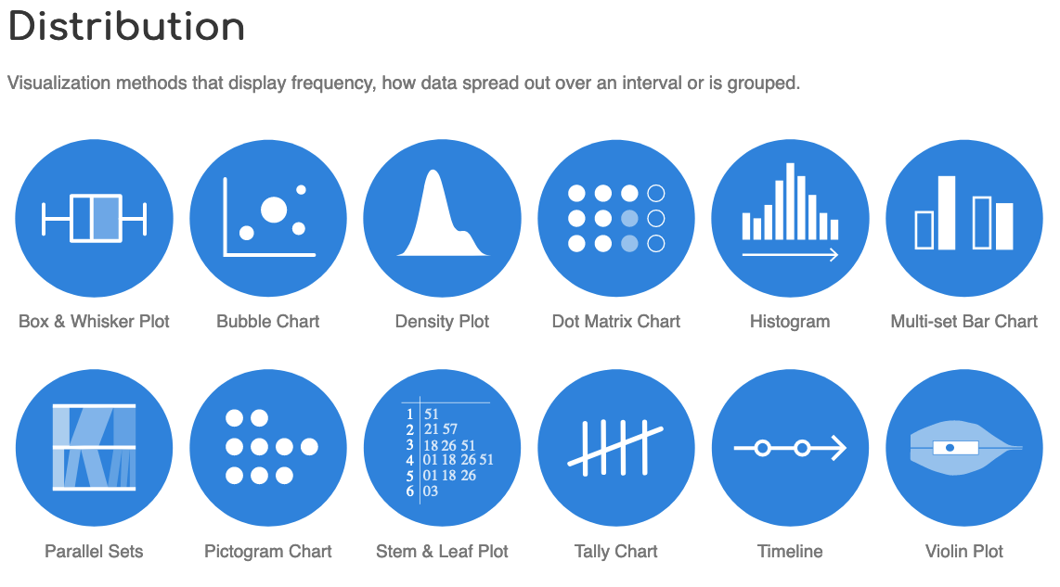
Ways to visualize data distributions:
Histogram
Box & Whisker Plot (Boxplot)
Bubble Chart
All require at least one variable to be numeric on an interval or ratio scale.
Notes:
Image source:
https://datavizcatalogue.com/search/distribution.html

Slide 5
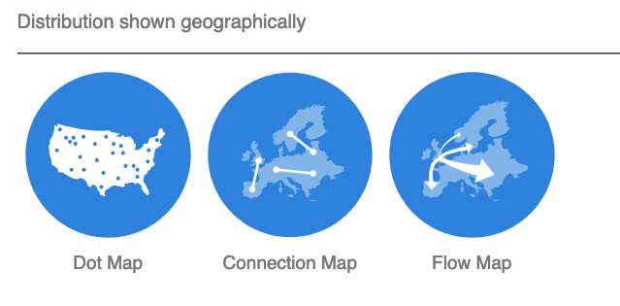
Ways to visualize data distributions (cont.):
Notes:
Image source:
https://datavizcatalogue.com/search/distribution.html

Slide 6
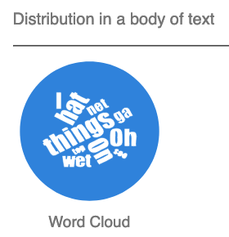
Ways to visualize data distributions (cont.):
Notes:
Image source:
https://datavizcatalogue.com/search/distribution.html

Slide 7
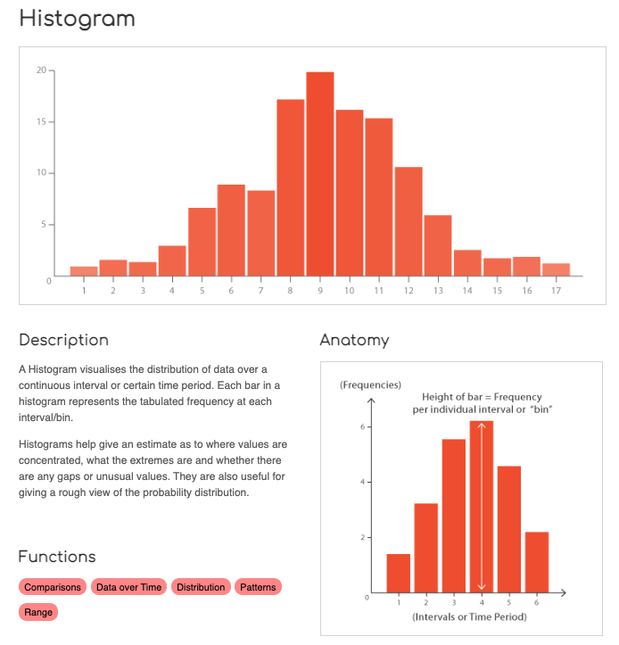
Notes:
Source:
https://datavizcatalogue.com/methods/histogram.html

Slide 8
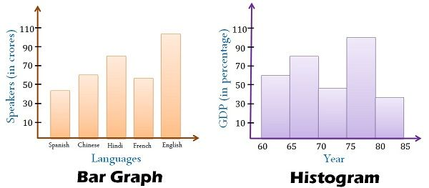
Some people confuse bar chart and histogram
They are not the same thing!
The X axis of a histogram displays data for a numerical variable that is on the interval or ratio level of data measurement (such as time or money), and the Y axis is another variable that is also on the interval or ratio level of data measurement. The Y axis variable can be a ratio level variable such as the frequency (count or % of total) of the value being indicated on the X axis. The Y axis variable can also be another completely different interval or ratio variable (such as GDP in the example image).
The X axis on a bar chart, however, displays data for a categorical variable that is on the nominal level of data measurement, and the Y axis is a variable that is on the interval or ratio level of data measurement. The Y axis variable can be the frequency (count or % of total) of the category being indicated on the X axis. The Y axis variable can also be another completely different interval or ratio level variable (such as "number of speakers" in the example image).
Notes:
Sources:
https://www.storytellingwithdata.com/blog/2021/1/28/histograms-and-bar-charts
https://keydifferences.com/difference-between-histogram-and-bar-graph.html

Slide 9
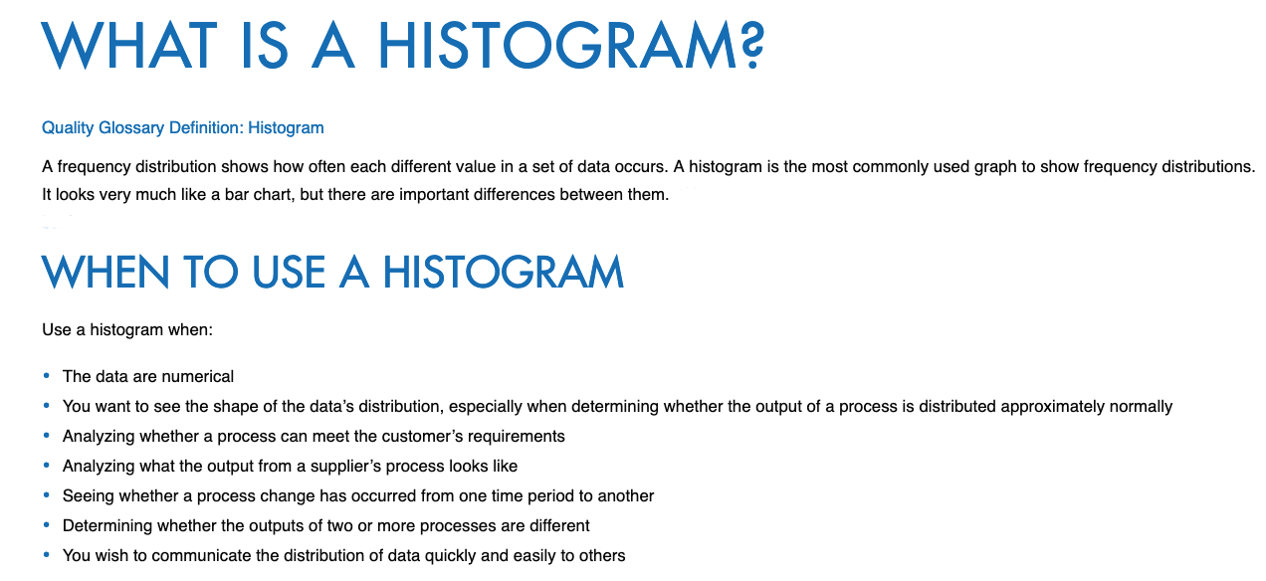
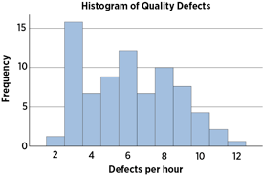
Notes:
Source:
https://asq.org/quality-resources/histogram

Slide 10
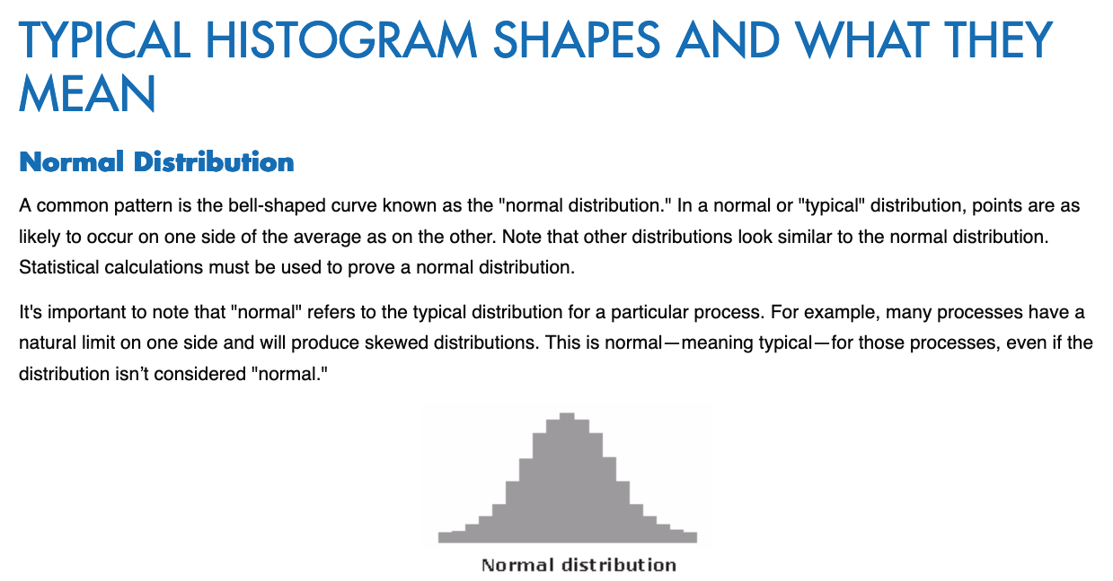
Notes:
Source:
https://asq.org/quality-resources/histogram

Slide 11

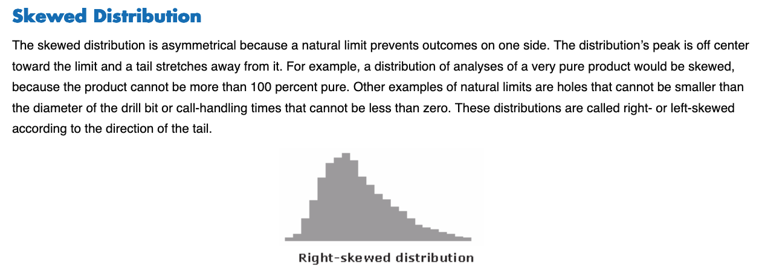
Notes:
Source:
https://asq.org/quality-resources/histogram

Slide 12
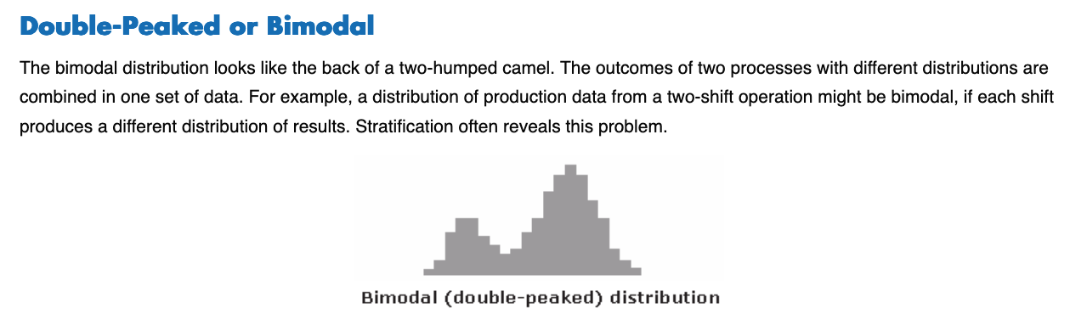
Notes:
Source:
https://asq.org/quality-resources/histogram

Slide 13
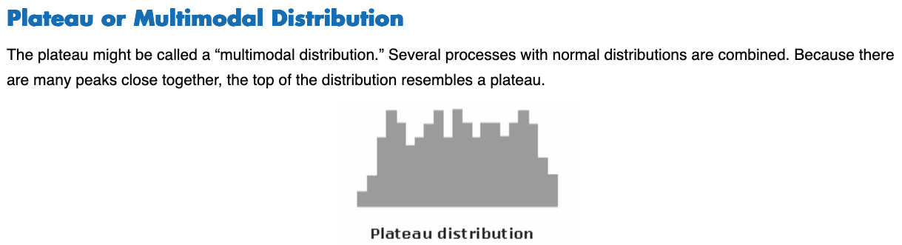
Notes:
Source:
https://asq.org/quality-resources/histogram

Slide 14
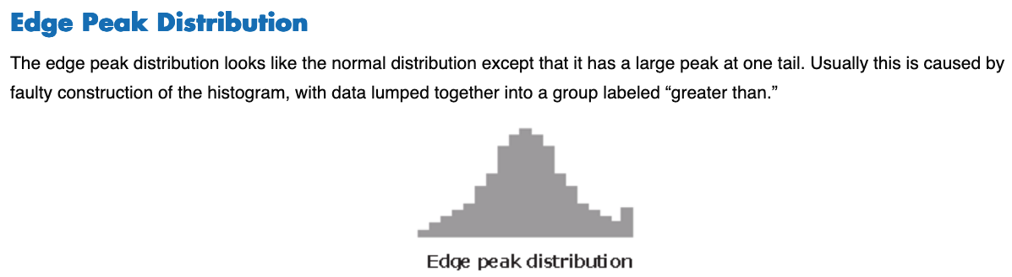
Notes:
Source:
https://asq.org/quality-resources/histogram

Slide 15
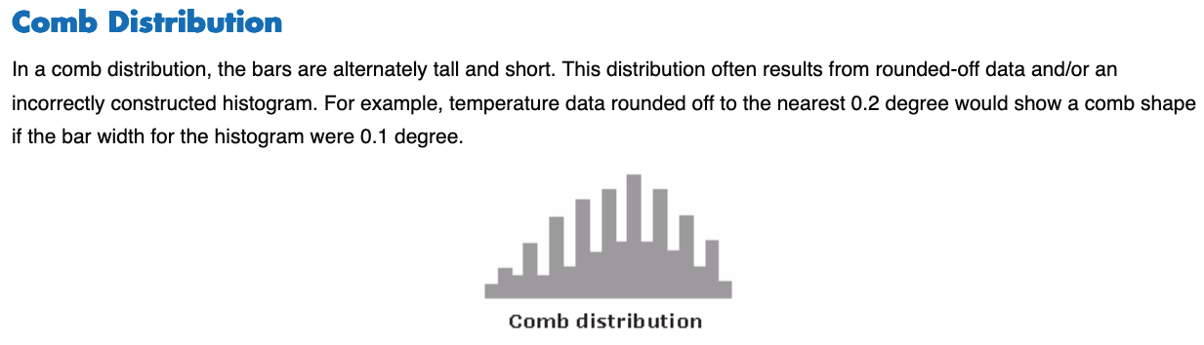
Notes:
Source:
https://asq.org/quality-resources/histogram

Slide 16
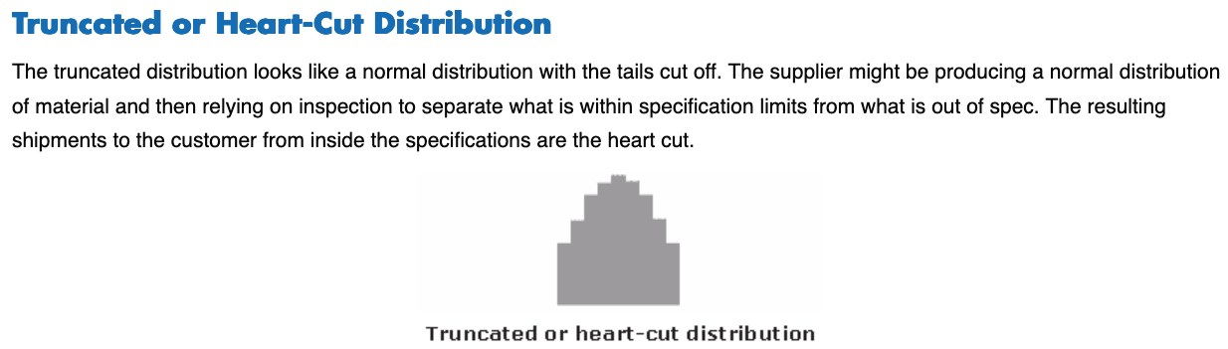
Notes:
Source:
https://asq.org/quality-resources/histogram

Slide 17
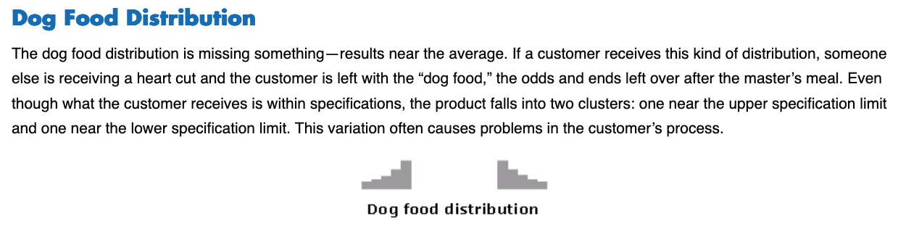
Notes:
Source:
https://asq.org/quality-resources/histogram

Slide 18
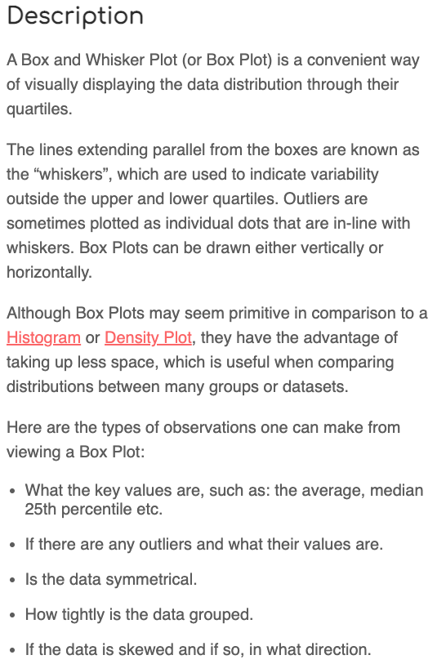
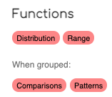

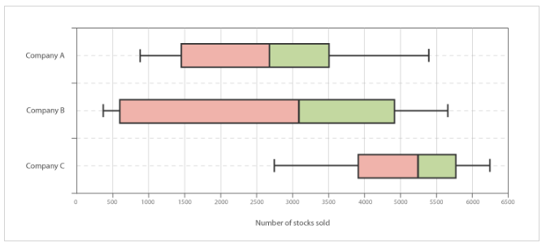
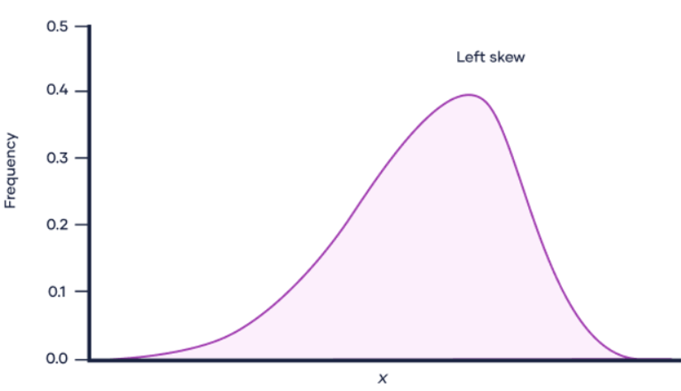
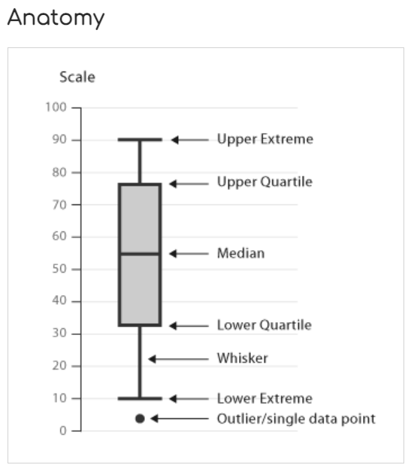
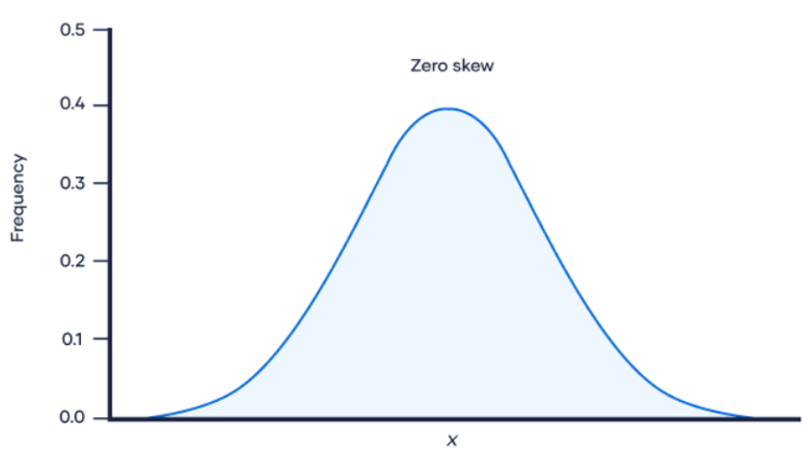
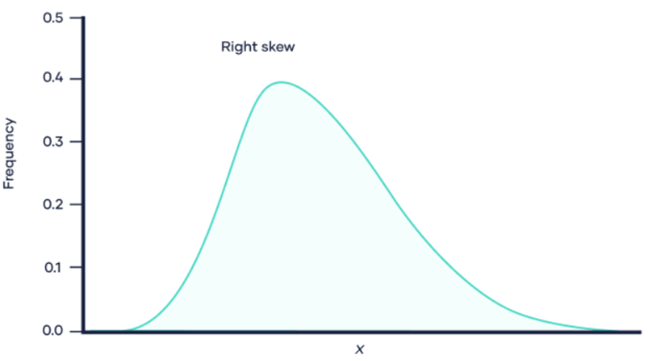
Notes:
Sources:
https://datavizcatalogue.com/methods/box_plot.html
https://www.scribbr.com/statistics/skewness/
More about quartiles:
“First quartile: 25% from smallest to largest of numbers. Second quartile: between 25.1% and 50% (till median). Third quartile: 51% to 75% (above the median). Fourth quartile: 25% of largest numbers.”
Source:
https://byjus.com/maths/quartiles/

Slide 19
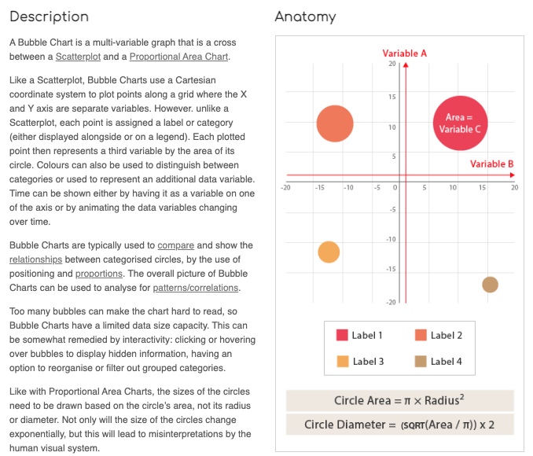

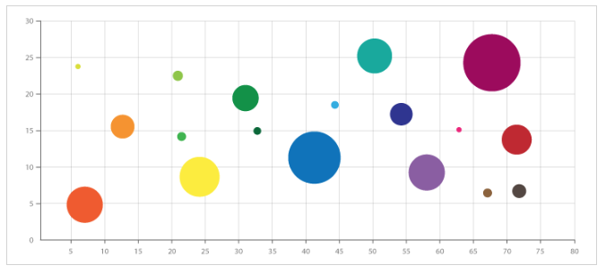

Notes:
Source:
https://datavizcatalogue.com/methods/bubble_chart.html

Slide 20
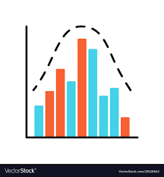
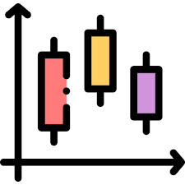
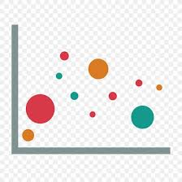
How to create data visualizations that show data distributions in Python:
Histogram
Box & whisker plot (Boxplot)
Bubble chart
← click On these links to go to the “How to…” for each in Python.
Notes:
Histogram in Python:
https://www.python-graph-gallery.com/histogram/
Boxplot in Python:
https://www.python-graph-gallery.com/boxplot/
Bubble chart in Python:
https://www.python-graph-gallery.com/bubble-plot/

Slide 21
How to create data visualizations that show data distributions in R:
Histogram
Box & whisker plot (Boxplot)
Bubble chart
← click On these links to go to the “How to…” for each in R.
Notes:
Histogram in R:
https://r-graph-gallery.com/histogram.html
Boxplot in R:
https://r-graph-gallery.com/boxplot.html
Bubble chart in R:
https://ggplot2.tidyverse.org/reference/geom_point.html

Slide 22
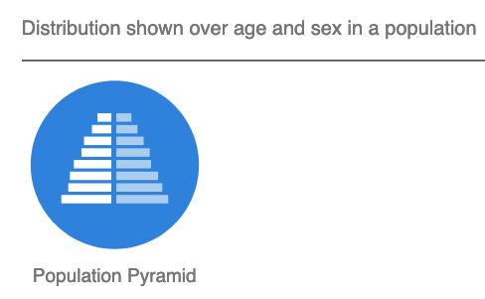
Click on the graphics to the right and explore the Data Visualization Catalogue website options for creating other data visualizations types that show Data Distributions.
The Data Visualization Catalogue provides an explanation of the anatomy of each DV type, code, and tutorials.
Notes:
Source:
https://datavizcatalogue.com/search/distribution.html

Slide 23


Remember the importance of data insights
Many people will be able to learn to create data visualizations.
But those that can extract and communicate data insights from the data visualizations stand out from the crowd!
The data insights piece is all about showcasing your critical thinking and communication skills (both in written reports and in verbal presentations).
Notes:
Image sources:
https://www.freepik.com/premium-vector/chosen-candidate-winning-applicant-get-new-job-hr-human-resources-hire-outstanding-candidate-employment-recruitment-concept-outstanding-businessman-magnifying-glass-among-applicants_31160355.htm
https://blog.harrisonassessments.com/blog/time-to-pick-the-winning-candidate-for-the-job.html

Slide 24
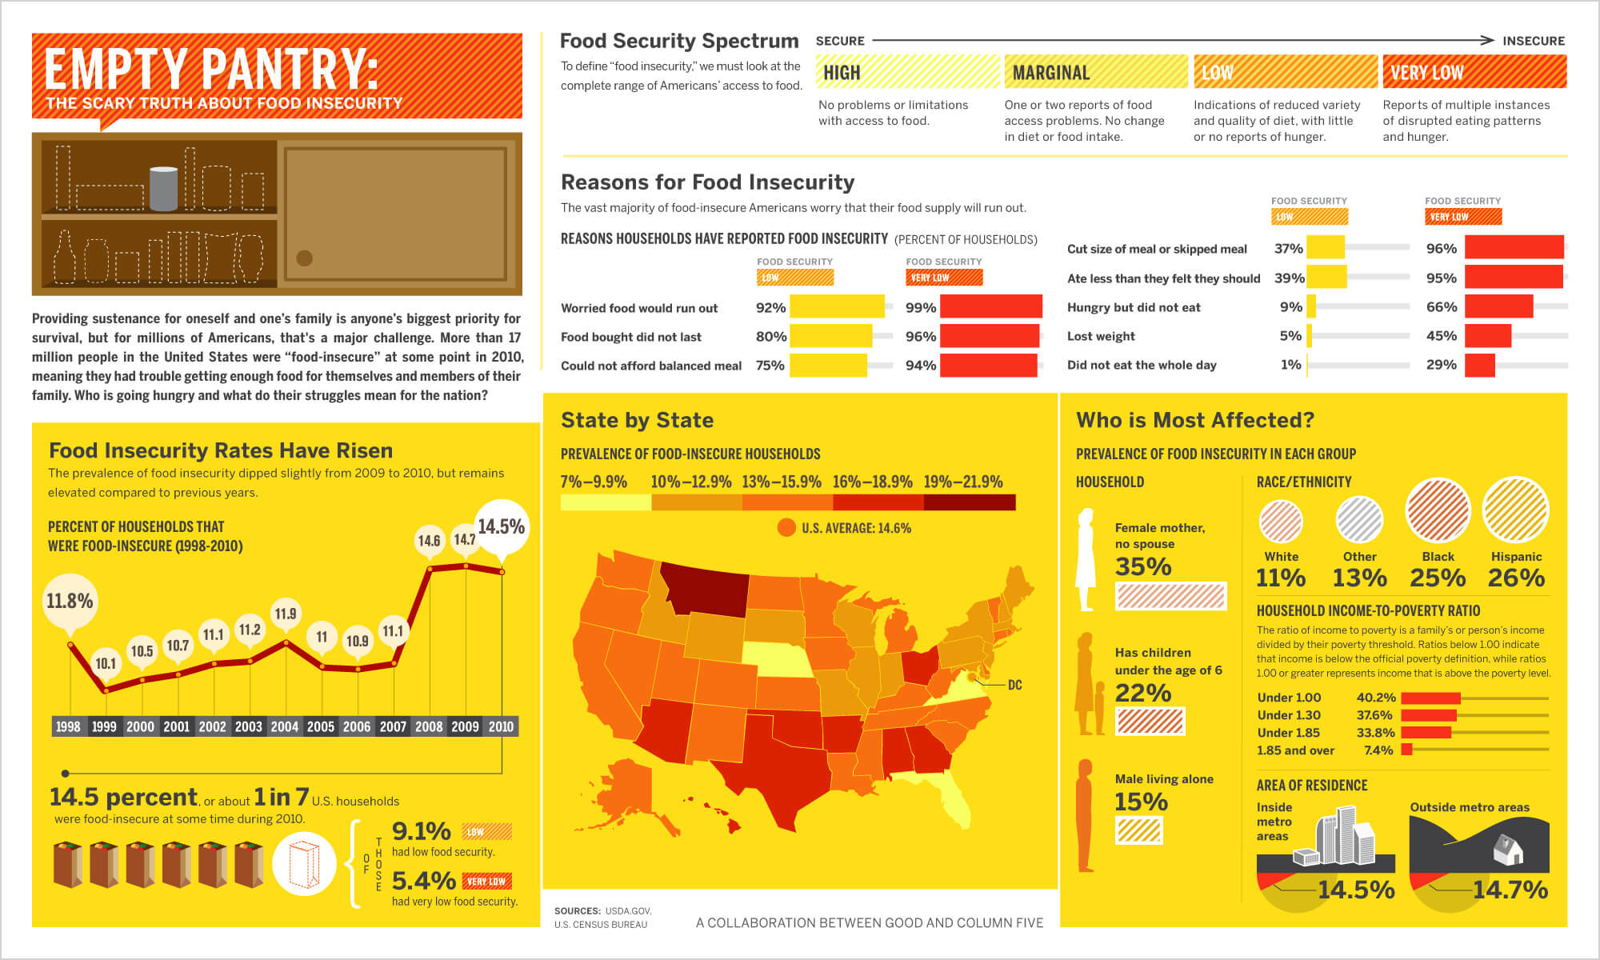
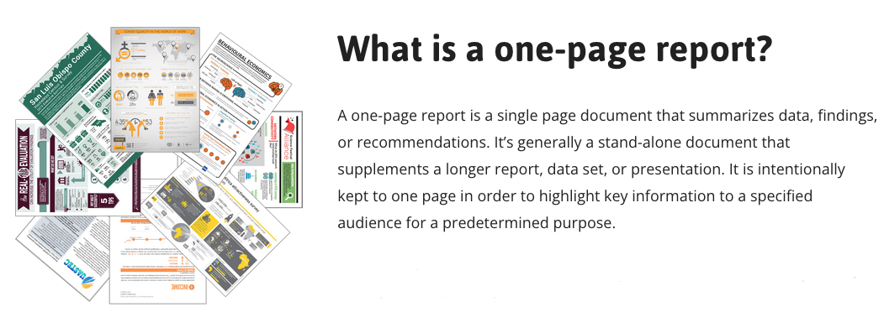
(Click the images or get the URLs from the notes section.)
The CS5 PPTX included one resource for examples and templates for creating a one-page report.
And the CS5 PPTX communicated the idea of getting with your team to check out the resource.
Notes:
Sources:
https://www.columnfivemedia.com/data-storytelling-brands-data-visualization/
https://evalu-ate.org/one-page-reports-toolkit/

Slide 25


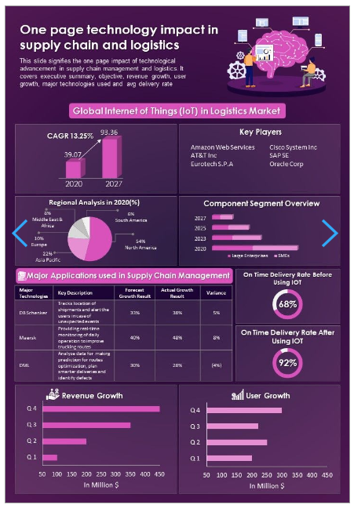
Well, here is an additional resource that also provides examples and templates for creating a one-page report.
Get with your team to check out this additional resource which explains and gives examples of one-page reports.
(Click the images or get the URL from the notes section.)
Notes:
Source:
https://www.slideteam.net/summary-page-of-government-annual-budget-document-ppt-pdf-doc-printable.html

Slide 26
End of file.

